Slide 1
Introduction to Digital Navigators

Slide 2
Today’s Agenda
Welcome
Key Definitions
What is a digital navigator?
What do digital navigators do?
Who are digital navigators?
Who do digital navigators serve?
Opportunities to Engage
Questions & Comments
Notes:
Abi

Slide 3
Presenters

Slide 4
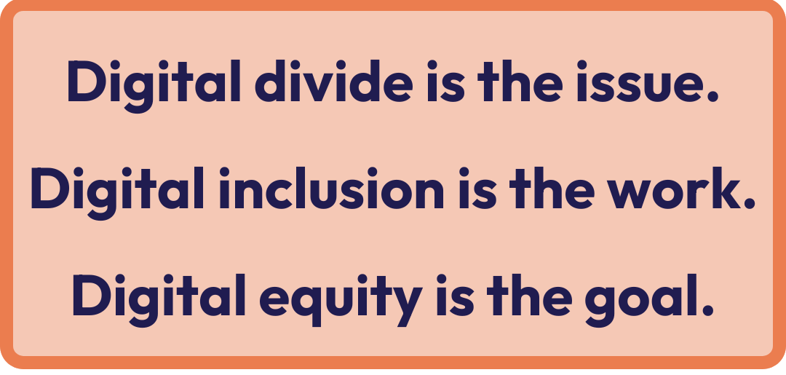
Digital Equity
Digital Inclusion
The condition in which all individuals and communities have the information technology capacity needed for full participation in our society, democracy and economy.
The activities necessary to ensure that all individuals and communities, including the most disadvantaged, have access to and use of Information and Communication Technologies
Notes:
Define some key terms used in the field
Walk audience through definitions - digital equity is the goal, digital inclusion is the work

Slide 5
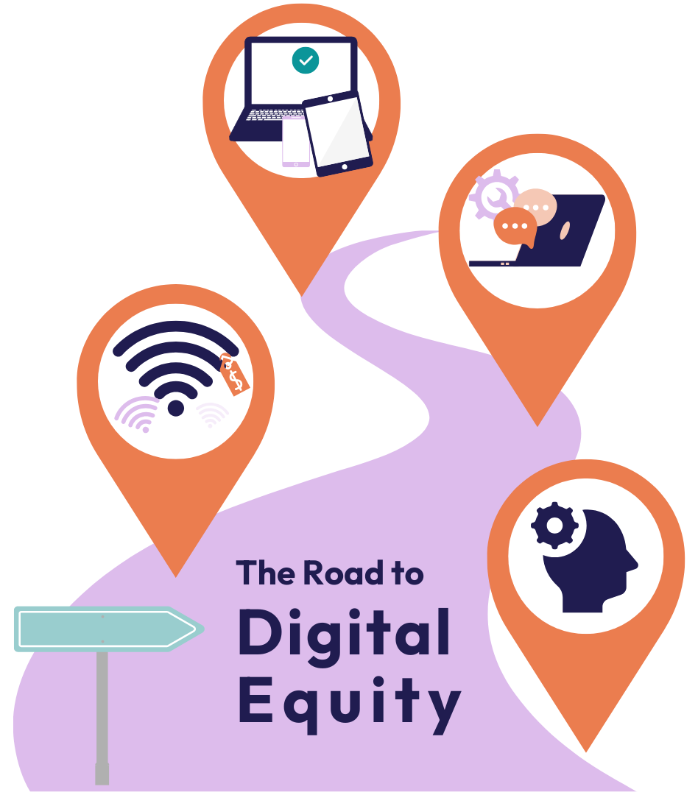
Elements of
Digital Inclusion
Affordable high-speed internet
Affordable and appropriate devices
Access to digital skills training
Quality technical support
Online content designed to enable self-sufficiency

Slide 6
Other words for the same ideas:
Opportunity
Access
Use and Adoption
What matters is the work you’re doing in your community.
Notes:
Acknowledge that terms equity and inclusion have become politicized: we’re defining them here so we can all know the jargon, but what is important is not the word but the idea. Digital equity means meeting people where they are. It means recognizing the simple truth that different people and different communities have different needs.
Emphasize importance of talking about concrete examples from this document

Slide 7
What is a Digital Navigator?
Notes:
Abi
One model for digital inclusion work is digital navigators

Slide 8
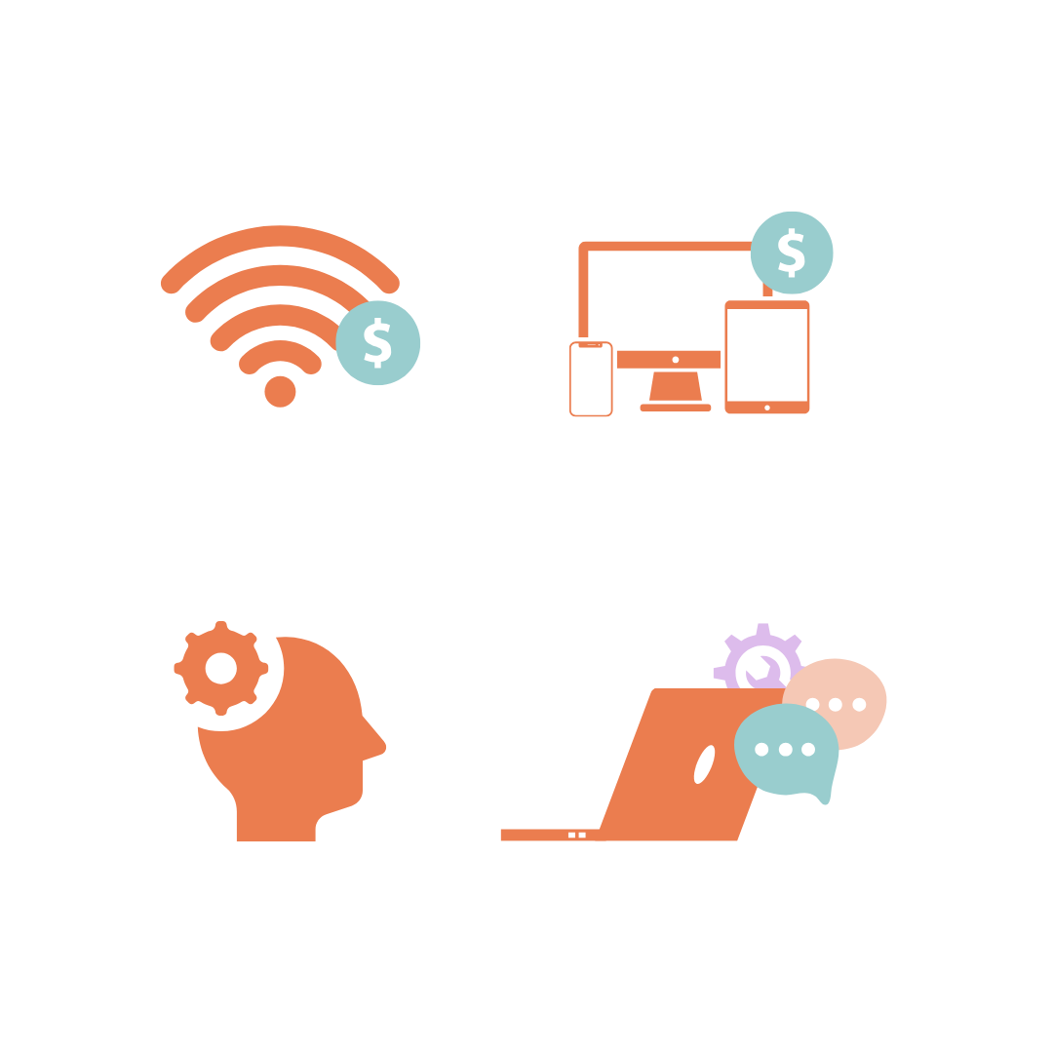
Key definition
Digital navigators are individuals who address the whole digital inclusion process — home connectivity, devices, and digital skills — with community members through repeated interactions.

Slide 9
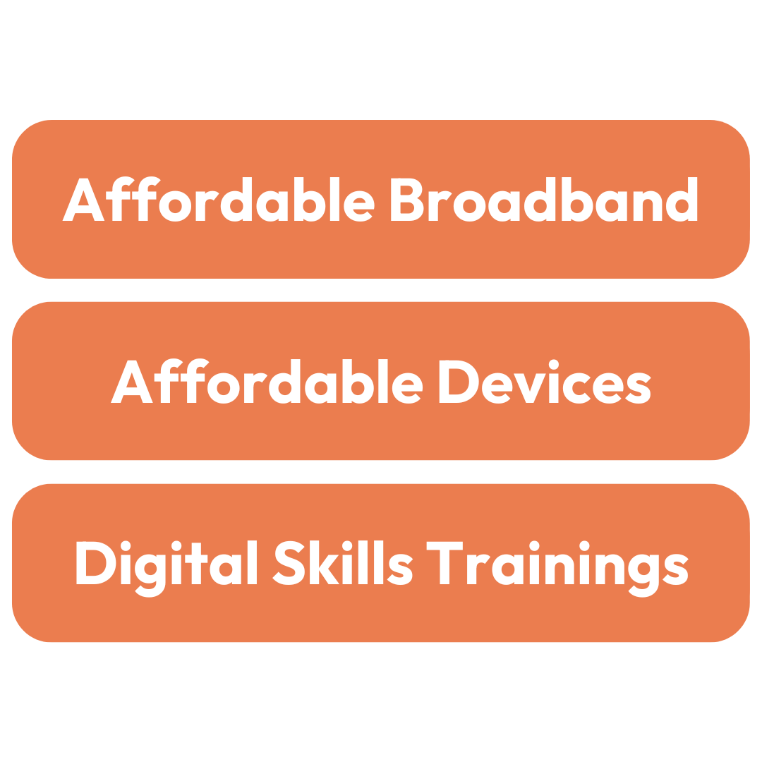

What role do navigators play?
ISPs / Benefit Programs
Digital navigators
Device refurbishers
& distributors
Tech class instructors
Notes:
How is this different from other roles?
DNs function as resource connectors, getting community members connected to all the services they need through one contact point.
Where benefit programs, tech classes, or device refurbishers may meet one of the needs a community member has in reaching their goals, a DN works with the person to make a plan to address all their needs.
This doesn’t mean they do it all themselves - many times they are referring customers to those community organizations that have been doing digital inclusion work for decades. Sometimes they directly do things like device distribution and skills instruction. But DNs function as the “front desk” for a digital inclusion community.

Slide 10
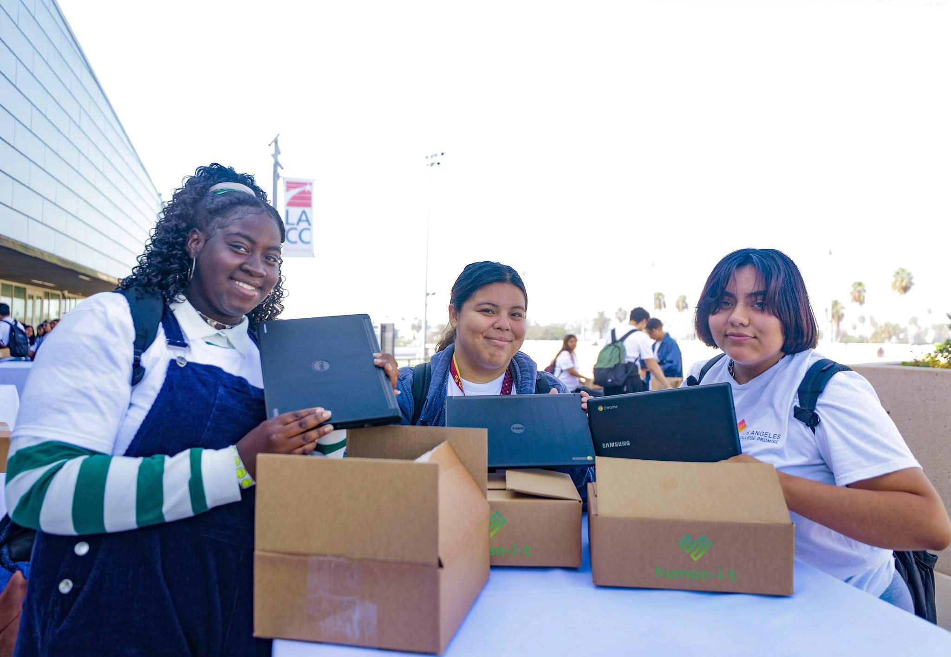
Growth of the Digital Navigator Model
Rooted in existing digital inclusion work, Emerged during the COVID-19 pandemic.
NDIA Digital Navigator Working Group produced definition, standards, template materials, & pilot programs
Flourished into a flexible and adaptable model.
Human I-T
Notes:
During COVID, practitioners were seeing that devices were getting to people but not being turned on, that internet subsidies were being offered but not used. It became obvious that a new model had to be developed that addressed all a community member’s digital inclusion needs at once instead of just one part at a time.
The term “digital navigator” was developed in 2020 and updated in 2024 to help bring together a community of practitioners doing similar work and provide a descriptor that was standard across many communities. Further the digital navigator model has evolved based on input and guidance from NDIA’s Digital Navigator Working Group and affiliate network.
The term DN was established to describe a model that emerged to provide one-on-one, ongoing, holistic digital inclusion assistance
NDIA developed the model and convened a working group of digital inclusion practitioners to develop best practices.
Typical early programs operated over the phone for on-demand support with urgent need.
Different kinds of digital navigator programs have developed over time.
over the phone, in person, or on video calls
on-demand services or through appointments
support both urgent needs and long-term digital inclusion goals
Most digital navigators still provide general digital inclusion support, but now some also offer specialized support for specific needs–telehealth, healthcare, or workforce development–and diverse populations, including people with disabilities, returning citizens, higher education students, and caregivers to K-12 students.
The digital navigator model is highly replicable and flexible enough to work in a number of different scenarios.
NDIA continues to act as a hub for free tools, shared resources, and community support to further define best practices for digital navigators.
NDIA intentionally does not “own” the model–it is open for everyone to implement.
—--------------------------------------------------------------
The digital navigator model was born in the NDIA community in 2020, when the pandemic changed our work in two key ways: (1) digital equity was more critical than ever, and (2) traditional methods of digital inclusion work were no longer viable due to social distancing. The term “digital navigator” was established to describe a model that emerged to provide one-on-one, ongoing, holistic digital inclusion assistance in areas such as connectivity, devices, and digital skills. Through conversations with the digital inclusion community, NDIA developed the model and convened a working group of digital inclusion practitioners to develop best practices.
Typical early digital navigator programs operated over the phone early in the pandemic, providing on-demand support for urgent needs related to general digital skills and access. Since then, we have seen a wide diversification of digital navigator programs, which now operate over the phone, in person, or on video calls. With on-demand services or through appointments, digital navigators support both urgent needs and long-term digital inclusion goals. Most digital navigators still provide general digital inclusion support, but now some also offer specialized support for specific needs–telehealth, healthcare, or workforce development–and diverse populations, including people with disabilities, returning citizens, higher education students, and caregivers to K-12 students.
The digital navigator model is highly replicable and flexible enough to work in a number of different settings and community groups. As the source for the digital navigator model, NDIA is also a hub for free tools and resources (under creative commons) and continuous community sharing to further develop best practices for digital navigators. NDIA intentionally does not “own” the model–it is open for everyone to implement and adapt with the common goal of advancing digital equity. NDIA will continue engaging the digital inclusion community while defining variations, best practices, and lessons learned.

Slide 11
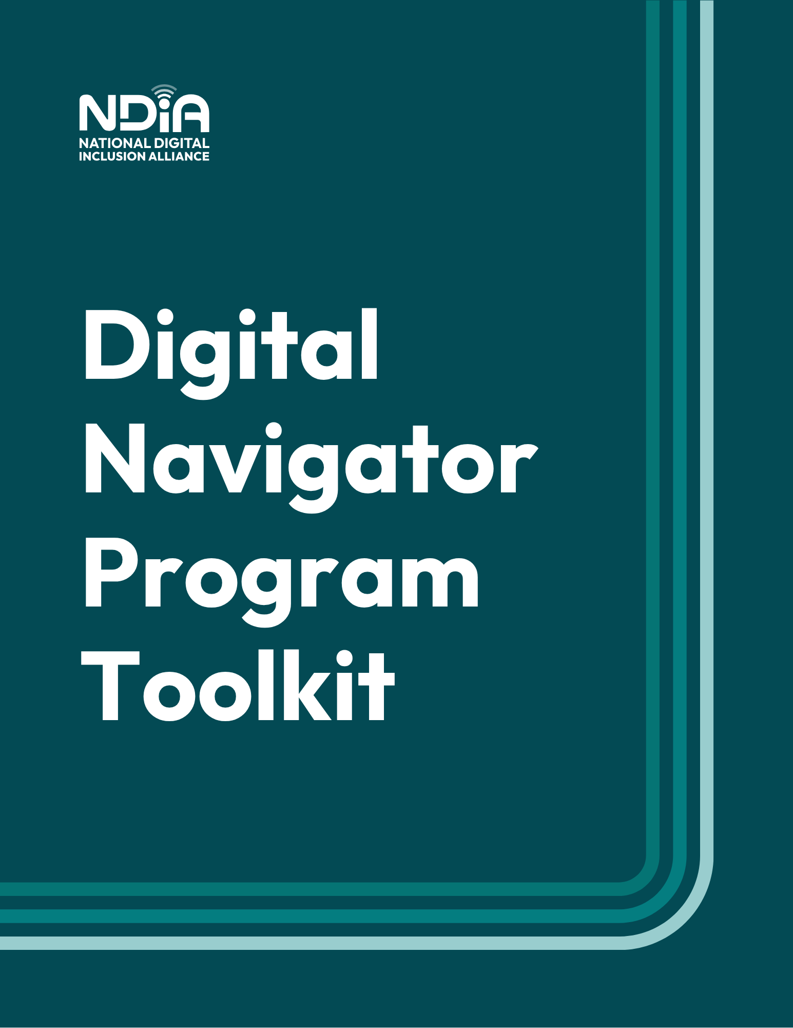
Resource
Digital Navigator Program Toolkit
5 years of experience from the NDIA community on how to build successful digital navigator programs
https://bit.ly/dntoolkit
Notes:
https://www.digitalinclusion.org/resource/2025-dn-toolkit/

Slide 12
What Do Digital Navigators Do?
Notes:
Abi
Now we know what a DN is. Let’s look more in depth at what DNs do.

Slide 13
Digital navigators consistently provide holistic, individualized support through
repeated
interactions.
Notes:
Digital navigators consistently provide holistic, individualized support through repeated interactions. (as needed)
But what does that mean?

Slide 14
Digital navigators consistently provide holistic, individualized support through
repeated
interactions.
Addressing all of the elements of digital inclusion: internet, devices, skills, tech support, & accessibility
Notes:
Holistic means clients receive simultaneous support for the interconnected elements of digital inclusion.
This means we try to connect people with resources to meet their needs for home internet, devices, and the skills they need to use them.

Slide 15
Digital navigators consistently provide holistic, individualized support through
repeated
interactions.
Community members are supported to meet their unique goals in ways that work for them.
Notes:
Individualized means clients are supported to meet their unique goals in the way that works best for them.
This means that DNs are largely working one-on-one with community members.

Slide 16
Digital navigators consistently provide holistic, individualized support through
repeated
interactions.
We build long-term relationships to ensure there’s a real impact.
Notes:
Consistent and repeated interactions mean a client has long-term support ensuring the solutions provided work.

Slide 17
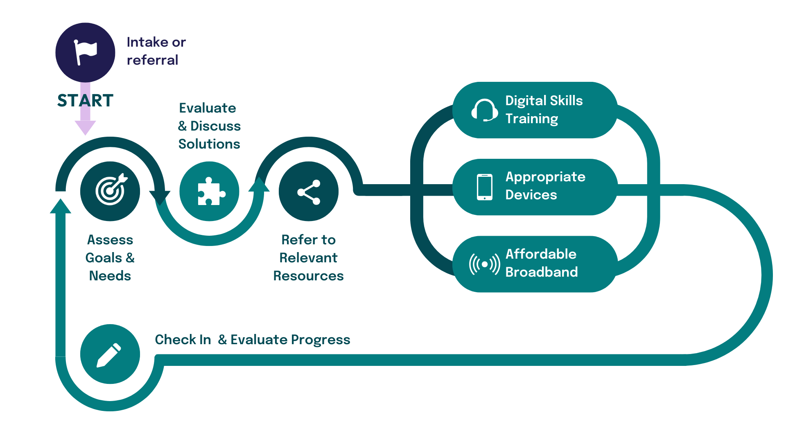






Digital Navigator Process
Identify Goals & Assess Needs
Evaluate & Discuss Solutions
Refer to Relevant Resources
Digital Skills Training
Appropriate Devices
Affordable Broadband
Check In & Evaluate Progress
Notes:
So what does that look like in practice? This demonstrate what happens during a digital navigator’s interaction with an individual.
DN asks a set of questions to assess their needs and existing resources.
Together DN & client evaluate and discuss the needs that have become apparent. These conversations include learning what the Community member prioritizes, how they would prefer to have those needs addressed, and what their goals are.
DN recommend digitals skills training, options for affordable connectivity, and devices that might be appropriate for their needs, even if the client only requests assistance in one area.
After client accesses these resources the DN will check-in to learn if the resources met their need and if additional support in needed. They'll evaluate their progress and they may return to an earlier step to refer to more resources and discuss how their needs may have evolved.
This process will repeat as many times as necessary until an individual feels that all their needs are met or they are prepared to take next steps towards their goals independently.
Share: https://www.digitalinclusion.org/resource/digital-navigator-process-explainer/

Slide 18



Assess & Evaluate Needs & Assets
Assess
Digital navigators should learn about:
client goals
existing skills and resources
client priorities and preferences
Evaluate
Digital Skills
Devices
Broadband
Check In
Notes:
Digital navigators should learn about:
client goals
existing skills and resources
client priorities & preferences
Resources:
Intake Form
Skills Assessment
Northstar Digital Literacy Assessment

Slide 19
Resource
Assessing Needs
NDIA’s DN Intake Form
NDIA’s DN Skills Assessment
Individual & Household Technology Check-up Tool
Northstar Digital Literacy Assessment
Notes:
https://www.digitalinclusion.org/resource/intake-form-template/
https://www.digitalinclusion.org/resource/skills-assessment-form-template/
https://www.digitalinclusion.org/resource/tech-checkup-tool/
https://www.digitalliteracyassessment.org/

Slide 20
Support for Digital Skill Learning
Assess
Digital navigators typically assist in three ways:
Referral to & coaching through existing digital skills resources
  Self-paced learning
  Classes
Providing 1:1 instruction
Leading group instruction
Evaluate
Digital Skills
Devices
Broadband
Check In
Notes:
Three types of digital skills support:
Coaching & Referral: refer clients to resources for learning skills independently between check-in meetings
1:1 Instruction: provide personalized, individual instruction over a series of meetings
Group Instruction: In some cases, DNs teach group classes. Participants are also supported by one on one interactions with DN.
Resource: NDIA blog as a guide to digital skills resources
—---------------------------------------------
Coaching & Referral
DNs may refer clients to resources for learning skills independently between check-in meetings to discuss questions and progress. They may also refer clients to group classes or organizations that support specialized skills.
1:1 Instruction
Clients receive personalized, individual instruction over a series of meetings as they learn digital skills relevant to their needs and at their pace.
Group Instruction
In some cases, DNs teach group classes. Topics are responsive to community requests. Groups provide opportunities for communities of learning and efficiency. Participants are also supported by one on one interactions with DN.
Resource: NDIA blog as a guide to digital skills resources

Slide 21
Resource
Digital skilling
NDIA blog: Planning to Build a New Digital Skills Curriculum? Read This First
Digital Bytes: Insights and Resources
Notes:
https://www.digitalinclusion.org/resource/intake-form-template/
https://www.digitalinclusion.org/resource/skills-assessment-form-template/
https://www.digitalinclusion.org/resource/tech-checkup-tool/
https://www.digitalliteracyassessment.org/

Slide 22
Assistance Accessing Affordable Devices
Digital navigators typically assist in
two ways:
Directly provide devices
Refer to device programs
All digital navigators should be
prepared to provide guidance
for selecting an appropriate device.
Assess
Evaluate
Digital Skills
Devices
Broadband
Check In
Notes:
Lo
Two types of digital skills support:
Directly provide devices
Refer to device programs
All digital navigators should be prepared to provide guidance for selecting an appropriate device.
Resources:
Expanding Device Availability for Broadband explainer
Digitunity

Slide 23
Resource
Devices
Expanding Device Availability
for Broadband explainer
Digitunity
Notes:
https://cdn.ilsr.org/wp-content/uploads/2022/04/ExpandingDeviceAvailabilityforBroadband.pdf
https://digitunity.org/

Slide 24
Appropriate & Affordable Broadband
To provide assistance, digital navigators:
understand available connectivity options
are prepared to discuss pros and cons based on client needs and priorities
know how to access free and
low-cost connectivity options
Assess
Evaluate
Digital Skills
Devices
Broadband
Check In
Notes:
To provide assistance, digital navigators:
understand available connectivity options
are prepared to discuss pros and cons based on client needs and priorities
know how to access free and low-cost connectivity options
Resources:
Free & Low-Cost Internet Plans Page
ACP Resource Page

Slide 25
Resource
Broadband
FCC National Broadband Map
Honor Roll of Low-Cost Internet Plans
EveryoneOn
Notes:
https://www.digitalinclusion.org/honor-roll-of-low-cost-plans/
https://www.everyoneon.org/

Slide 26
Who Are Digital Navigators?
Notes:
ASK: what are the skills you think would be necessary to be a successful digital navigator?

Slide 27

Qualities of a Digital Navigator
Members of the Community They Serve
Empathetic
Patient
Problem solvers
Trusted
Culturally competent
Reliable
Service oriented
Flexible
Digital Charlotte
Good humor
Adaptable
Find job description at digitalinclusion.org/dn
Notes:
There are some critical skills and aptitudes identified by digital inclusion practitioners, which are captured in a baseline job description that is available on our website.
First of all, we recommend hiring from whatever community is being served because that will ensure that digital navigators will have a strong cultural competency and a basis of existing trust.
Teaching ​basic technological concepts related to internet services, computer and device characteristics, and common online services and applications.
Self-organization, language capacity, humor, and cultural competency.
Ability to creatively solve problems, and negotiate and handle stressful situations in a positive manner.
Ability to provide excellent customer service, establish appropriate boundaries with clients, and ​to demonstrate innovation and flexibility.
Digital Navigators do not need to be I.T. experts but they do need to have a basic understanding of Technology Concepts. They should be comfortable enough to learn new technology skills independently as needed.
So rather than seeking folks with a strong technical background, it is important that digital navigators can communicate with clients in language they can understand, with good humor, and creatively solve problems while providing excellent customer service.

Slide 28
Resource
Digital navigator hiring
NDIA Digital Navigator Baseline Job Description
NDIA Digital Navigator Interview Question Bank
Notes:
https://www.digitalinclusion.org/resource/dn-job-description/
https://docs.google.com/document/d/1LCWTqGo6jgwYwCVjayPw7jj7YjNIM5I9RHvSne4Cg98/edit?usp=sharing

Slide 29
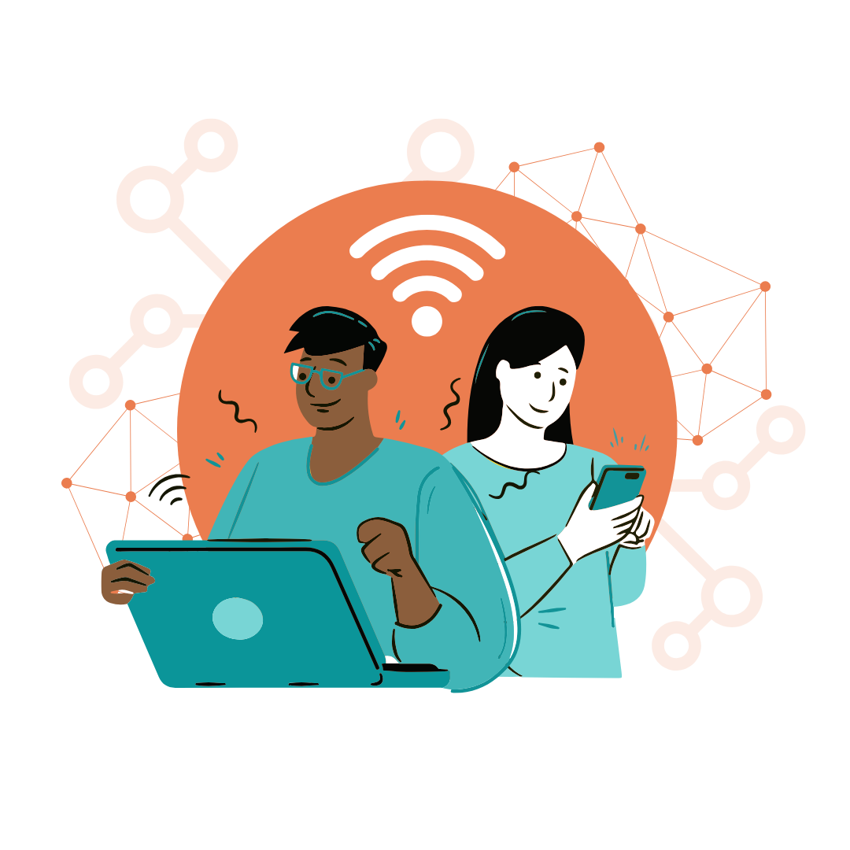
Digital Navigator Training
Areas of Training
Orientation to Digital Inclusion
Understanding Audience & their Needs
Asset Mapping & Resources including:
  Digital Skills & Frameworks
  Internet Options
Evaluation & Reporting
Accessibility, Adult Education, and Boundary Setting
Notes:
NDIA has developed an initial training for digital navigators that we typically provided remotely in about 6 hours for groups that choose to contract with us.
The objectives for that training are that:
1. Trainees will understand and recognize what Digital Inclusion is and how activities support building digital equity in their communities.
2. They will be equipped with the resources and local information necessary to address Digital Inclusion holistically. This means they are able to reliably assess client need and recommend courses of action regarding the three primary areas of need that we’ve discussed.
Areas of Training
Orientation to Digital Inclusion
Digital Divide Data & Research
Understanding Audience & their Needs
Asset Mapping & Resources including:
Digital Skills & Frameworks
Internet Options & the Affordable Connectivity Program
Evaluation & Reporting
Just to give a perspective of what training DNs might look like, NDIA has developed an initial training for digital navigators that we typically provided remotely in about 6 hours across 4 days for groups that choose to contract with us.
The objectives for that training are that:
1. Trainees will understand and recognize what Digital Inclusion is and how activities support building digital equity in their communities.
2. They will be equipped with the resources and local information necessary to address Digital Inclusion holistically. This means they are able to reliably assess client need and recommend courses of action regarding the three primary areas of need that we’ve discussed.
We do this by beginning with an orientation to DI generally, and then guide DNs in learning about the data and research available on their target audience.
With those two components, DNs are equipped to understand their audience and their needs. We build on that by training DNs to uncover information about those needs through conversations with individuals, for example, if an individual says they want to start online banking, they may first need help establishing an email address and they may wish to learn about online security so that they feel comfortable interacting with their bank online. So DNs are trained to drill down into a request to determine what steps might need to be taken to reach the goal an individual presents.
We also lead DNs in mapping the assets and resources available to them and their audience locally, so they are familiar and comfortable with providing those options as needed.
And of course we teach DNs to gather data for the evaluation and reporting on their program.

Slide 30
Resource
Digital navigator training
NDIA Digital Navigator Training
DigitalLIFT
World Education & Goodwill
Marylanders Online
Notes:
https://events.humanitix.com/digital-navigator-training-2026-03-cohort
https://digitallift.org/online-courses/
https://www.coursera.org/specializations/goodwill-digital-navigator-certificate
https://marylandersonline.umd.edu/give-help/marylanders-online-navigator-education-toolkit-monet/

Slide 31
Staffing Examples
Existing staff:
Cohort of interns:
Full-time staff:
Southeastern New York Library Resources Council:
Cross-trained 150+ existing staff in libraries and community based organizations.
City of San Diego:
Hired 13 interns to serve as digital navigators embedded in community based organizations.
National Digital Navigator Corps:
Organizations in rural areas or that serve Tribes each hired a full-time employee to serve as a digital navigator.
Notes:
The model is flexible and had been adapted to a variety of situations, for example:
cross-trained staff across a region,
embedded interns serving within community partners while receiving centralized support
dedicated full-time hires adding DN to their organization’s existing services.
There may be other successful staffing scenarios.
We’ve also seen skilled volunteers and decentralized coordinated digital navigators across a community like in Charlotte and Columbus
Caution
Low-pay and part-time positions lead to turnover and less effective support
Volunteers may not have the same scheduling commitments, removing the consistency from the digital navigator experience. High turnover rates for casual volunteers can also result in a much heavier lift for training.

Slide 32
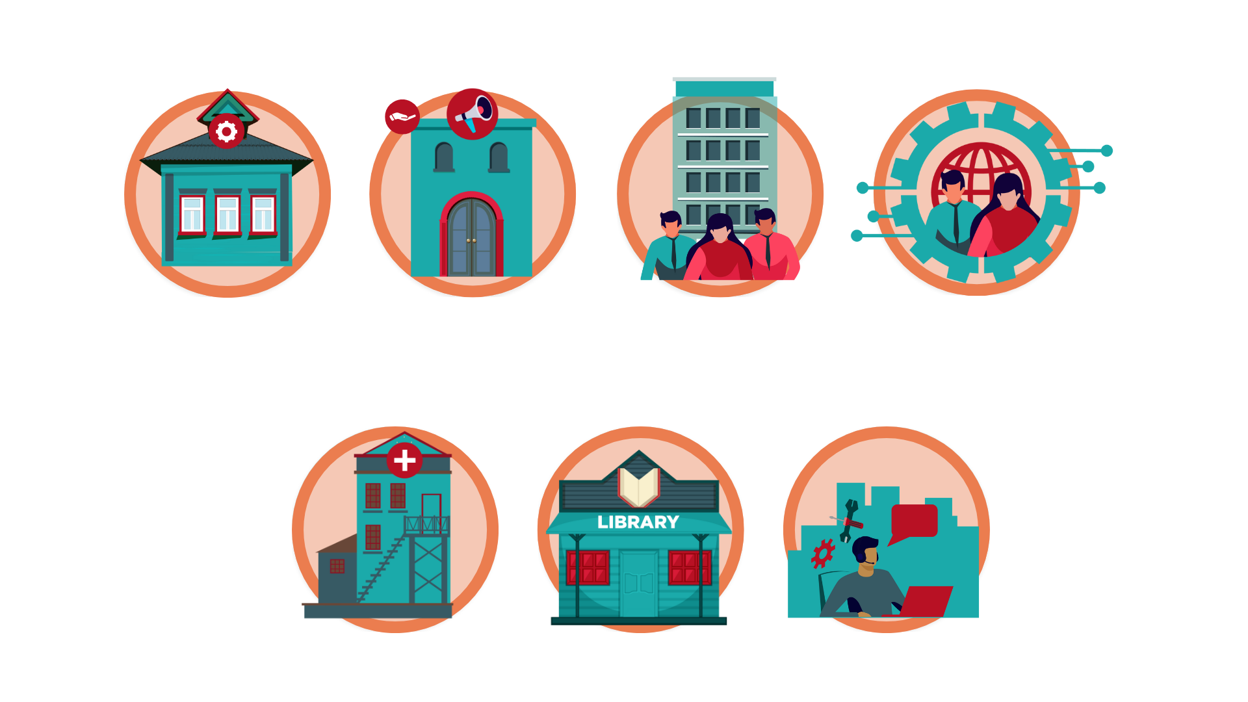
Digital navigators are based in trusted organizations.
Different organizations are trusted by different communities

Slide 33
Who Do Digital Navigators Serve?
Notes:
Lo

Slide 34
Identify Target Communities
Denver Public Library offers digital navigator services in branches in neighborhoods with high numbers of digitally disconnected households.
Seattle Housing Authority targeted English Language Learners, and partnered with local organizations to provide assistance in Somali, Vietnamese, Spanish and more.
Digital Connect Initiative - Gila River partners with elder center to pair digital skills learning circles with meals and provides instruction on tablets distributed by the Tribal Council.
Find data to identify target areas on NDIA's Data and Research Page
Notes:
Programs target clients in their communities based on need and alignment with their organizational mission.
Examples:
Denver public library offers digital navigator services in branches in neighborhoods with high numbers of digitally disconnected households.
Seattle Housing Authority - Targeted English Language Learners, and partnered with local organizations to provide assistance in Somali, Vietnamese, Spanish and more.
Digital Connect Initiative - Gila River, partners with elder center to pair digital skills learning circles with meals and provides instruction on tablets distributed by the Tribal Council.
NDIA’s Data and Research Page describes available data sources

Slide 35
Resource
Identify target communities
NDIA Research and Data page
NDIA Asset Mapping page
NDIA Digital Equity Researcher Inventory
Notes:
https://www.digitalinclusion.org/research-data/
https://www.digitalinclusion.org/asset-mapping/
https://www.digitalinclusion.org/resource/digital-equity-researcher-inventory/

Slide 36

One-on-one interactions mean
community members receive individualized support.
Example:
Christina, a client of Salt Lake City Public Library’s digital navigators, was more successful when receiving individualized support:
“I contacted the digital
navigator project because
I read about it in the paper.
I’d had several periods of
instruction in using a computer but that kind of instruction had gone in one ear and out the other. I think that’s because I don’t speak computer language.”
Notes:
Christina was an early client who helped articulate why the digital navigator model worked for her.

Slide 37


Repeated interactions build trust
and provide a human connection.
Example:
Repeated interactions with a Connect Arizona digital navigator supported Chris’s small business goals:
Example:
Digital navigators at Hamden Public Library helped build self-confidence through
social-emotional technology learning:
“I struggle with learning and the repeated tutoring has helped me keep my head on straight and keep all this crazy tech knowledge. Could not have gotten my businesses up and running without you.”
“I know I can count on the digital navigators, they gave me confidence in myself.”

Slide 38


Vantage’s digital inclusion program supported Ronnie’s journey towards learning digital skills.
“I was a little bit apprehensive,” said Ronnie, “I had my schooling and work history, but I knew I needed to upgrade my computer skills. The Digital Inclusion program and Digital Navigators gave me the confidence to learn these new skills. I needed some direction and guidance and a formatted plan for my study. I didn’t know all the aspects of these new digital applications and tools.”

Slide 39
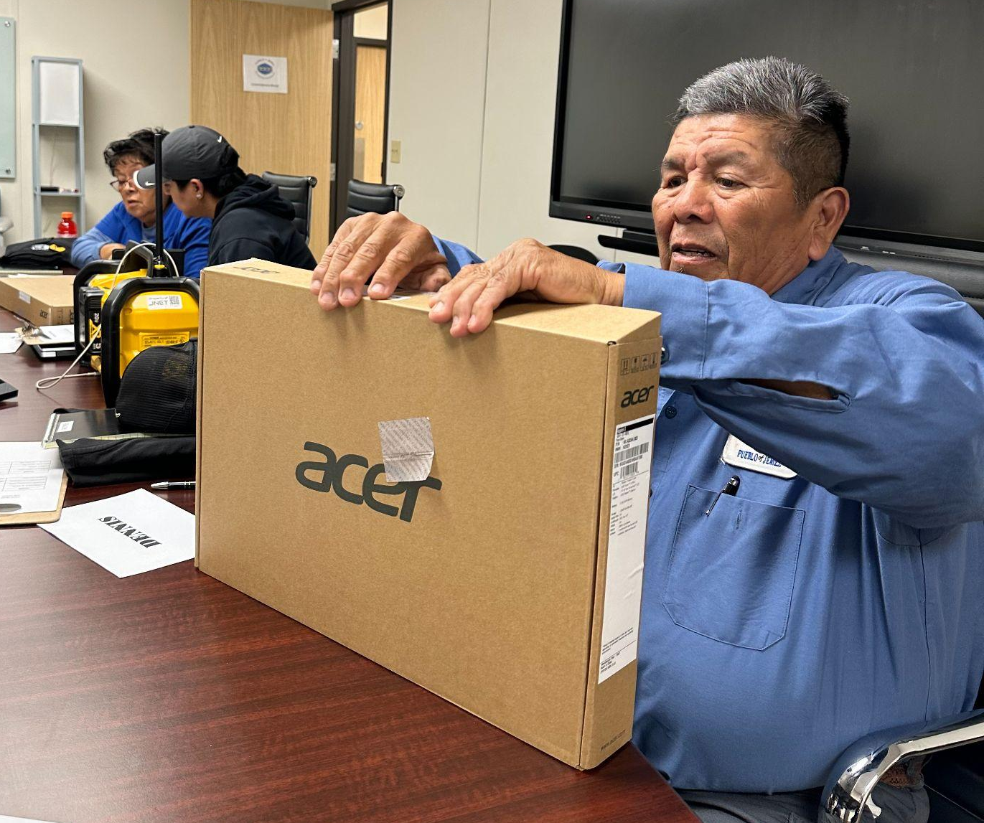
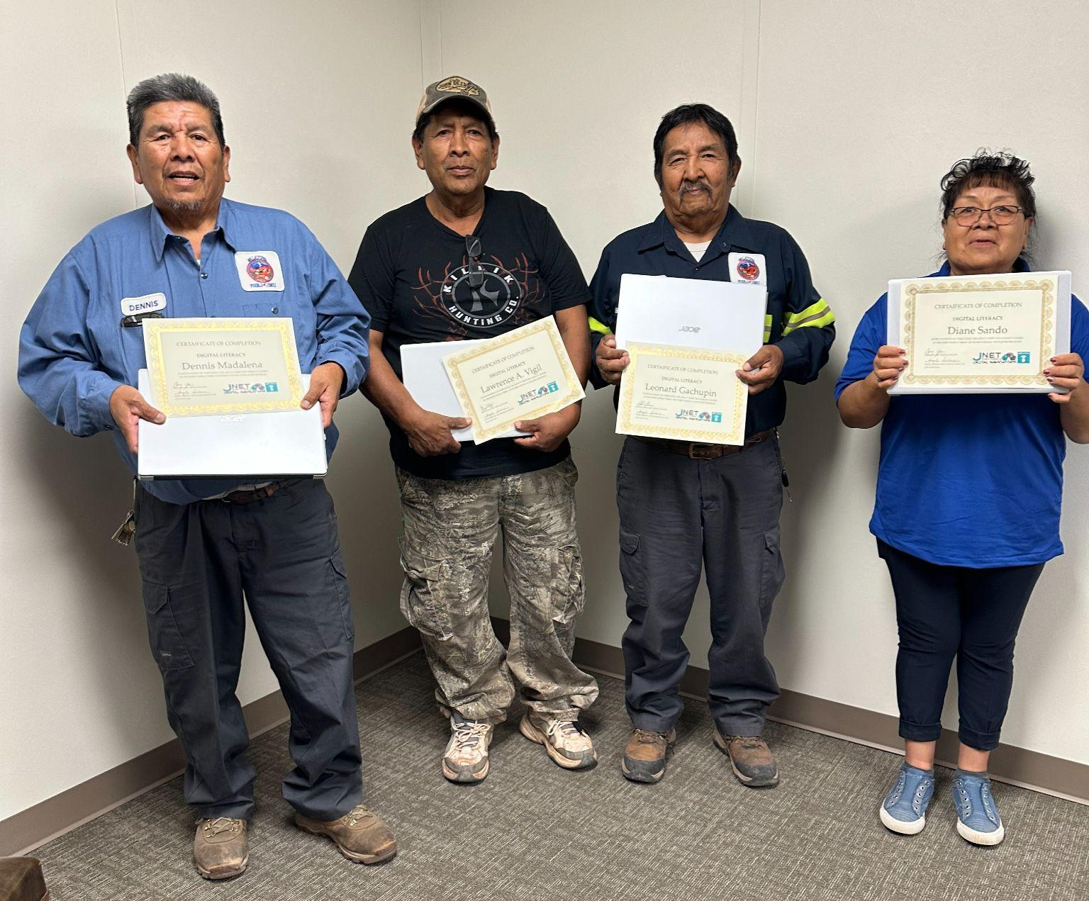

Jemez Pueblo Tribal Network digital navigators provide devices to members of the Tribe who may have never had a computer before.
“We looked at the Tribal workers who are field workers and not at a computer all day. We picked five Tribal employees who were not computer literate and started our pilot program. We were able to purchase laptops and give them to the clients to learn. We are using Towa, our
native language, to teach our clients.”
Notes:
Started pilot program June 1st and every Thursday in June. 2 hour long adult basic computer/digital skills training. We looked at the tribal workers who are field workers and not at a computer all day, and our tribal programs moved to online timesheets and i could hear concerns of the employees worried about getting their timesheets done. So we are on session 3 today on learning how to use their new laptops. We are using Towa our native language to teach our clients. So far the classes are going great. We are using NorthStar for assessments and determine what we need to focus on the needs and also to use a guide for the clients to learn on their own.
We didn't have much responses as we advertise our DN program. So we reached out to our public works department and focus on Janitors and Custodians. We picked 5 employees who were not computer literate and started our pilot program. 2 hour sessions every Thursday the entire month of June. We were able to purchase laptops and give them to the clients to learn. Our hope is the clients will spread by word of mouth their experience and we will start with a regular flow of clients to use DN program. ACP we are still struggling hope to make changes very soon.
We did experience a little difficulty implementing and I had to look where the digital divide was affecting our employees. Our departments moved to digital online timesheets and I could hear employees thinking how they will be able to perform their timesheets or put in for PTO. So I went ahead and spoke to Director of Public Works to help me launch a pilot program to help his employees get basic digital literacy training. He recommended 5 of his employees he saw struggling. I had to give it a little push to launch our first pilot program. Turned out successful.

Slide 40

Computer Reach provided devices and training to a non-profit, volunteer fire department to build trust and support public safety across an entire community.
“With access to critical devices and comprehensive digital skills training, the project has helped us significantly improve our life-saving emergency services and enhanced our response capabilities to fire protection and other critical situations.”
Dave Lambert, Chief
Cokeburg Volunteer Fire Co.
Notes:
“The Washington Co Digital Navigator Project has been a game-changer fro the emergency services in Cokeburg borough, specifically for the Cokeburg Volunteer Fire Department. With access to critical devices and comprehensive digital skills training, the project has helped us significantly improve our life-saving emergency services and enhanced our response capabilities to fire protection and other critical situations. The project’s support has bridged the gap between our aspirations and financial constraints, enabling us to better serve our community with faster and more efficient responses. We are immensely grateful for their support and excited about the positive impact it will have on our department’s operations and the safety of our residents.” - Dave Lambert, Chief, Cokeburg Volunteer Fire Co. Washington, PA

Slide 41
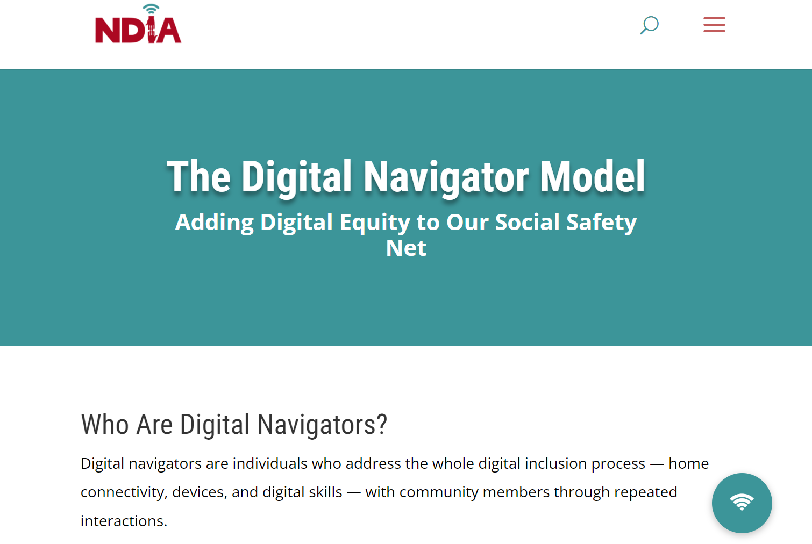
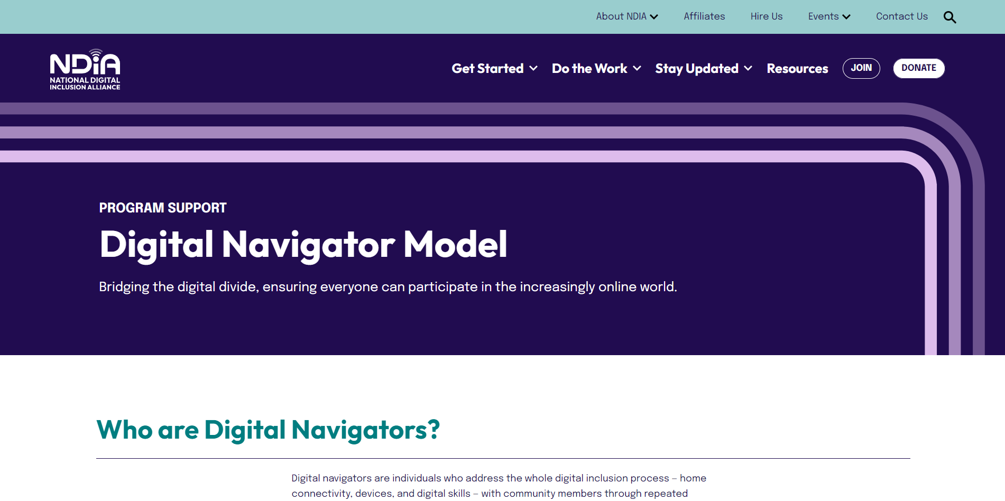
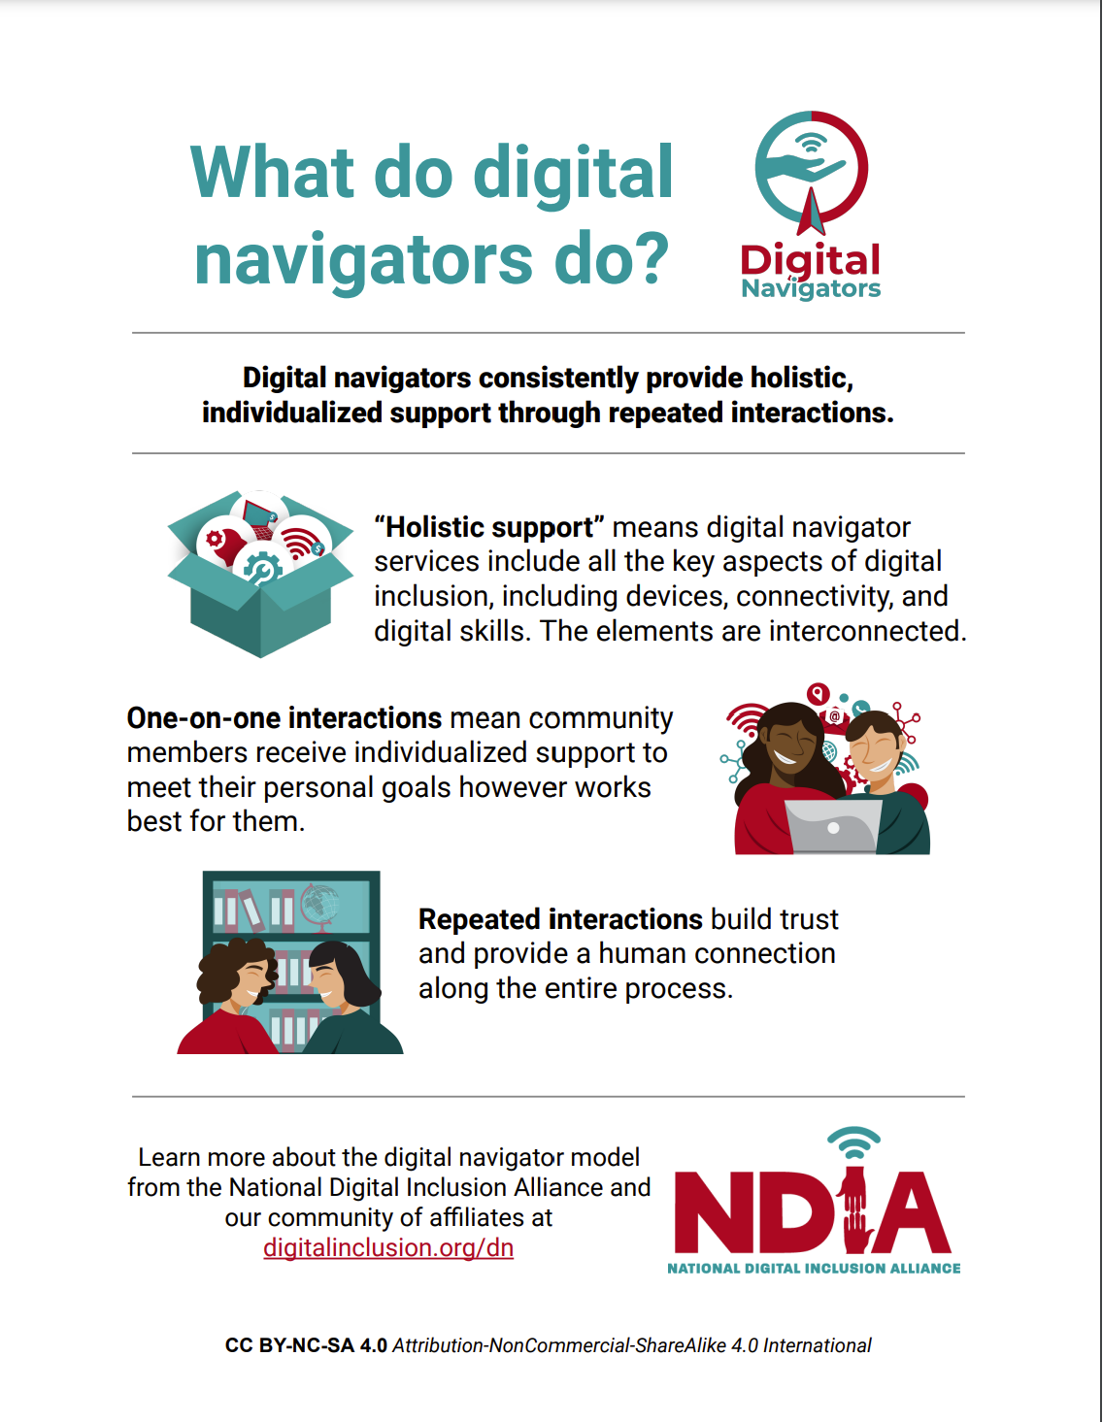
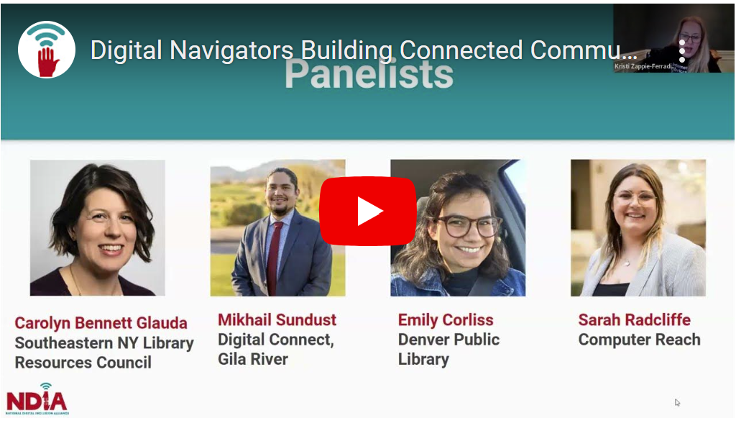
Resources at digitalinclusion.org/dn
Materials such as:
Job description
Intake form
Skills assessment
One-pagers
Process explainer
Webinars
Notes:
Abi
On our digital navigator model page, we collect and share best practices from the community, as well as materials that can be adapted and reused, including the baseline job description and forms I mentioned.

Slide 42
Questions?
Notes:
Use chat or raise hand feature

